Slide 1
One Bible : One Story
What Story Are You Living In?
Chris Wright

Slide 2
What do you think the Bible is?
The Bible is not just….
  A book full of promises
  A book full of doctrines
  A book full of rules
  A book full of history
The Bible is fundamentally a story - or rather
  THE STORY – The grand narrative of the universe
  It is a DRAMA in SEVEN ACTS.

Slide 3

God’s Big Story
A drama in seven acts
God
God
New Creation
Redeemed
Humanity
Earth
Humanity
1
Creation
2
Rebellion
3
God’s People BC
4
Christ and Gospel
5
God’s People AD
6
Final
Judgment
7
New Creation

Slide 4
The great Bible story
Act 1 - Creation
God
Humanity
The Earth

Slide 5
The great Bible story
Act 1 - Creation
God – One, living, good, sovereign, Creator
Humanity – Image of God: to rule and to serve within God’s creation
Earth – Belongs to God; entrusted to us
    Work, rest, produce, sharing, ecology, economy, etc.

Slide 6
God’s Big Story
A drama in seven acts
God
Earth
Humanity
1
Creation
2
Rebellion

Slide 7
The great Bible story
Act 2 - Fall
Corruption of every area of created life - spiritual, intellectual, physical, social
Brokenness – at every level
    Individual
    Society
    Creation
The Bible’s radical and comprehensive diagnosis of sin.

Slide 8
God’s Big Story
A drama in seven acts
God
Earth
Humanity
1
Creation
2
Rebellion
3
God’s People BC

Slide 9
The great Bible story
Act 3 – O.T. Promise
God
O.T.Israel
The Land
All nations
The Earth

Slide 10
The great Bible story
Act 3 – O.T. Promise
Abraham – blessing, all nations
Exodus – redemption and covenant
Sinai – the O.T. law
Narratives – Conquest, Judges, Monarchy, Exile, Return
Prophets – Idolatry, justice, economic and political power, international sovereignty of God, future vision.
Psalms
Wisdom
Remember: The journey, the promise, the priority of redemptive grace.

Slide 11
God’s Big Story
A drama in seven acts
God
Earth
Humanity
1
Creation
2
Rebellion
3
God’s People BC
4
Christ and Gospel

Slide 12
The great Bible story
Act 4 – Gospel, Christ
Incarnation
The Kingdom of God
The teaching and example of Jesus
The Cross and Resurrection
The Ascension and Christ’s present reign

Slide 13
God’s Big Story
A drama in seven acts
God
Earth
Humanity
1
Creation
2
Rebellion
3
God’s People BC
4
Christ and Gospel
5
God’s People AD

Slide 14
The great Bible story
Act 5 – N.T. mission of church
Pentecost! Power, presence, of Holy Spirit
The identity and role of the church, as God’s messianic and missional community
Mission to all nations
The teaching of the epistles

Slide 15
God’s Big Story
A drama in seven acts
God
Earth
Humanity
1
Creation
2
Rebellion
3
God’s People BC
4
Christ and Gospel
5
God’s People AD
6
Final
Judgment

Slide 16
The great Bible story
Act 6 – Final Judgment
Satan and evil will not have the last word, but will be utterly destroyed from God’s universe
The ultimate consequences of sin will fall on those who refuse to repent
God will deal with all wrongdoing, and will put all things right
Judgment is therefore part of the gospel – it is good news!

Slide 17
God’s Big Story
A drama in seven acts
God
God
New Creation
Redeemed
Humanity
Earth
Humanity
1
Creation
2
Rebellion
3
God’s People BC
4
Christ and Gospel
5
God’s People AD
6
Final
Judgment
7
New Creation

Slide 18
The great Bible story
Act 7 – New Creation
The return of Christ - hope
The new creation (Rev. 21-22)
God will ‘make all things new’
What kind of people should we be in expectation of that?

Slide 19
God’s Big Story
A drama in seven acts
God
God
New Creation
Redeemed
Humanity
Earth
Humanity
1
Creation
2
Rebellion
3
God’s People BC
4
Christ and Gospel
5
God’s People AD
6
Final
Judgment
7
New Creation

Slide 20
What does this do?
It shows us how we got our Bible
The Bible is the “product” of God’s mission through its own whole story:
God’s engagement with God’s world,
through God’s people,
for God’s purpose
- the redemption of God’s creation

Slide 21
What does this do?
2. It shapes our worldview. We answer all the fundamental questions out of the Bible’s “big story”.
  Where are we? (what is the world we live in?)
  Who are we? (What does it mean to be human?)
  What’s gone wrong? (why is the world in a mess?)
  What’s the solution? (what can be done about it?)
  Where will it all end? (is there any hope for the future?)
  How should we then live?

Slide 22
What does this do?
It puts us into God’s story.

Slide 23
God’s Big Story
A drama in seven acts
God
God
New Creation
Redeemed
Humanity
Earth
Humanity
1
Creation
2
Rebellion
3
God’s People BC
4
Christ and Gospel
5
God’s People AD
6
Final
Judgment
7
New Creation

Slide 24
What does this do?
It puts us into God’s story.
We participate in act 5,
in the light of all we know from acts 1-4
(the O.T and N.T.)
and in anticipation of acts 6 and 7
(the return of Christ).

Slide 25
What does this do?
It puts us into God’s story.
So, I don’t just “apply the Bible to my life”,
but rather,
“how can I apply my life to the Bible,
as a participant in its great story?”

Slide 26
What does this do?
4. It challenges us to live the story we are in
Colossians 1:9-11.
9 We continually ask God to fill you with the knowledge of his will through all the wisdom and understanding that the Spirit gives,
i.e. Know God’s story
10 so that you may live a life worthy of the Lord and please him in every way: bearing fruit in every good work, growing in the knowledge of God,
i.e. Live by God’s standards
11 being strengthened with all power according to his glorious might so that you may have great endurance and patience,
i.e. Prove God’s strength

Slide 27
What does this do?
  5. It sends us out to play our part in the mission of God.
  Eph. 1:9-10
  God’s mission is to redeem the whole of creation, broken by sin and evil, into the new creation, populated by redeemed people from every culture, through the cross and resurrection of Christ.
  Every part of life, then, including our daily work, participates in the mission of God

Slide 28
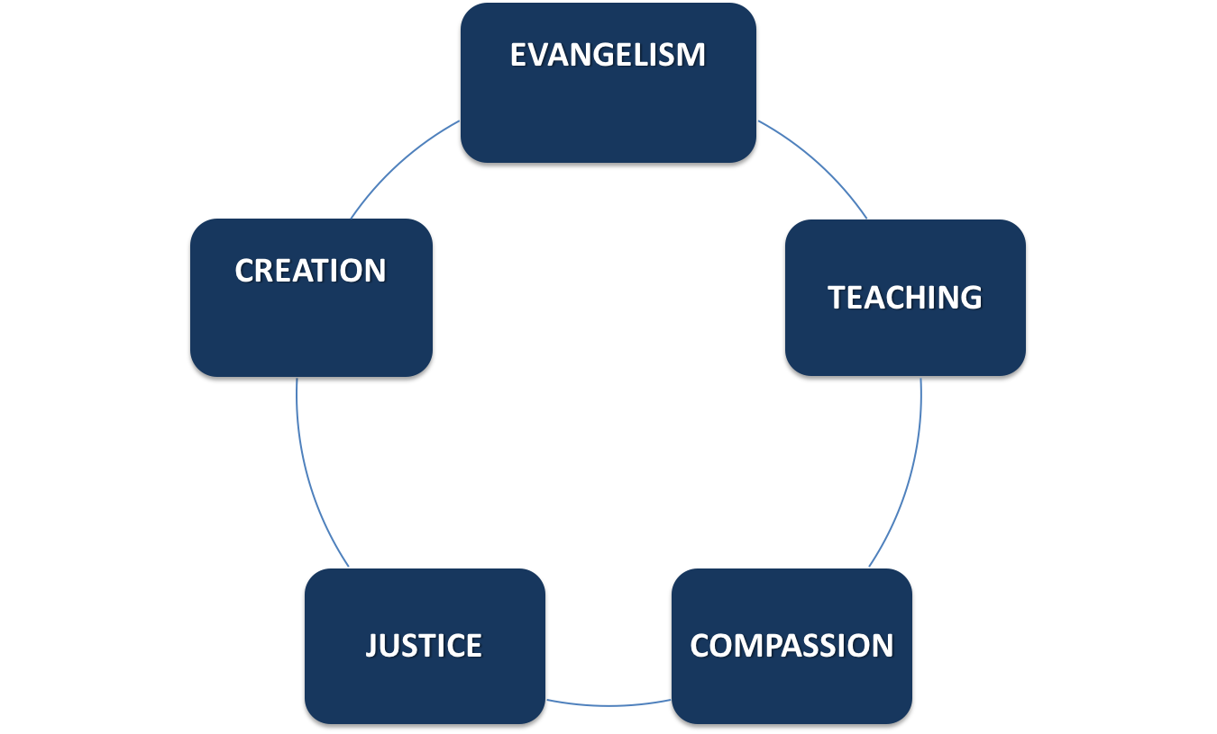

“The five marks of mission”

Slide 29
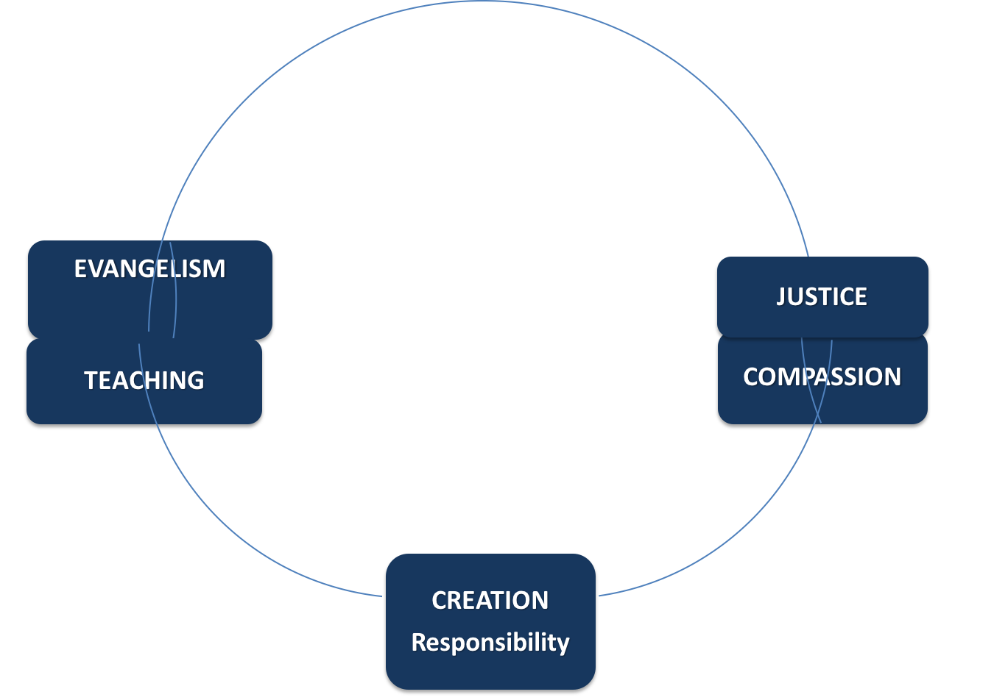

Church, Society, Creation
Building the church
Serving society
Ruling and caring for creation

Slide 30
Triple focus
The mission of God addresses
Individual persons
Society and culture
Creation
“All three are broken and suffering because of sin; all three are included in the redeeming love and mission of God; all three must be part of the comprehensive mission of God’s people.”
Cape Town Commitment I.7a

Slide 31
So what?
God’s whole mission is for God’s whole church
  But everybody can’t do everything
The whole church’s mission includes every church member
  But we have different callings and sendings
Every church member’s mission includes the whole of life.
  Jesus is Lord – of all.

Slide 32
God’s Big Story
A drama in seven acts
God
God
New Creation
Redeemed
Humanity
Earth
Humanity
1
Creation
2
Rebellion
3
God’s People BC
4
Christ and Gospel
5
God’s People AD
6
Final
Judgment
7
New Creation

